Slide 1
Cooper Yungblut
Project Notebook

Slide 2
9/25/2018 from 3:30PM - 8:00PM
Division of labor decided, at least for now. Tasks will be split up and shared as we figure out more on how much time they will take.
GANTT chart base given by Joseph. Initial GANTT for our group edited by me. It needs some work.
Budget created by Lin.
After the basics were out of the way we began researching our topics and discussed what we would need to present on 9/26.
Joseph and I created a block diagram for the overall project.

Slide 3
9/25/2018 from 10:00PM to 2:00AM
Team working individually from home for presentation.
I researched Electronic Loads for a few hours.
Watched a few video tutorials over how to make one, most were not very helpful.
Found a resource from a Keysight Technologies blog post about how electronic loads worked. I tried to make their basic design for a Constant Current using LTSpice (next slide) but it didn’t want to work correctly, so I’m shelving it for now.
Kept in contact with group during this time to ensure we’d have a presentation ready by the 2AM deadline.

Slide 4
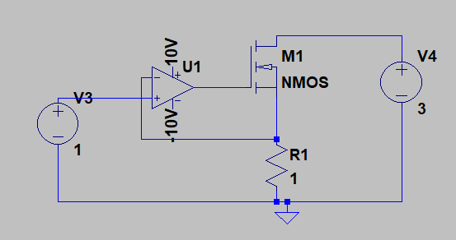
First Attempt at basic Constant Current Electronic Load Design
Did not want to perform correctly, probably need to get a more specific op-amp for LTSpice

Slide 5
9/27-10/3
Switched from working on the Electronic Load portion of the project to working on the curve tracer.
Began research on Curve Tracer design

Slide 6
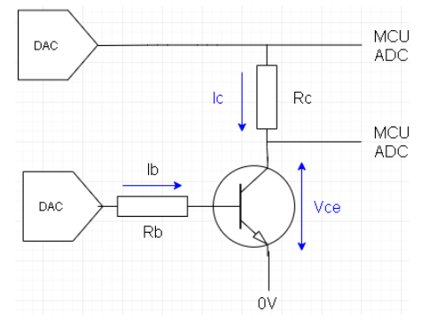
Initial Curve Tracer Design for NPN BJT

Slide 7
10/4-10/10
Research designs for a more complete system that would include curve tracer circuits for multiple types of transistors.
Sawtooth and stairstep functions for testing
First attempt at building basic Curve Tracer and creating a graph from the data found

Slide 8
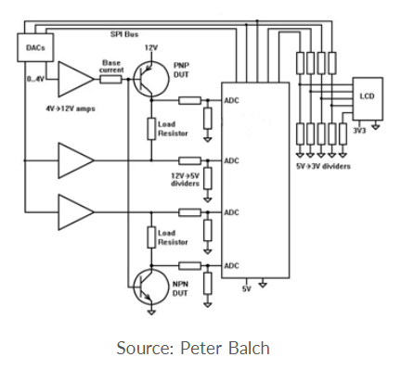
More complete Curve Tracer

Slide 9
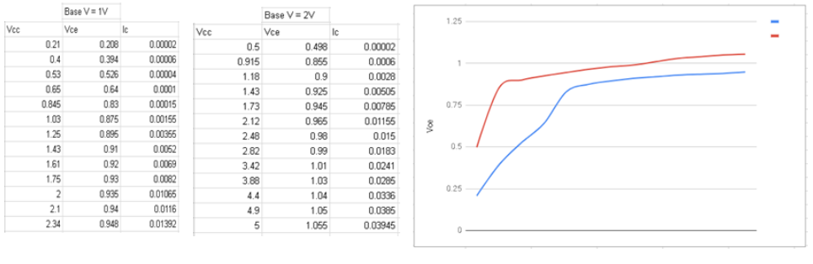
Data/Graphs from Initial Test

Slide 10
10/11-10/17
Research a remake of the Curve Tracer design
Begin researching parts for Curve Tracer

Slide 11
10/18-10/24
Draw up new Curve Tracer Schematic
Figured out how to power the system via AC/DC power supplies, 30V/2A and 5V/6A
More research on parts for Curve Tracer

Slide 12
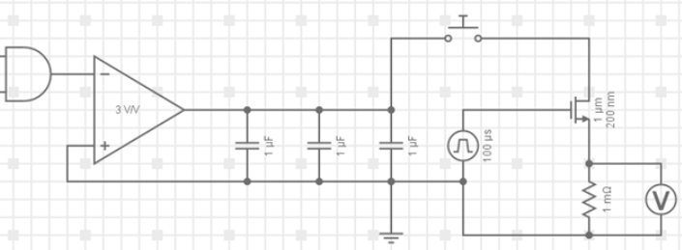
Initial Curve Tracer Schematic V2

Slide 13
10/25-10/31
Draw up a more updated schematic
Build prototype for Curve Tracer V2, burned my op amp. Definitely need a Gate Driver and Switch so that the transistor isn’t always on during testing.
Chose a Digital Potentiometer to control the curve tracer for testing – AD5220

Slide 14
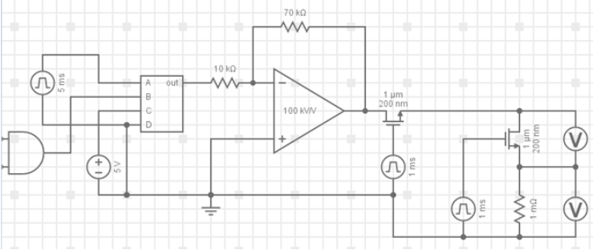
Curve Tracer Schematic V2.1

Slide 15
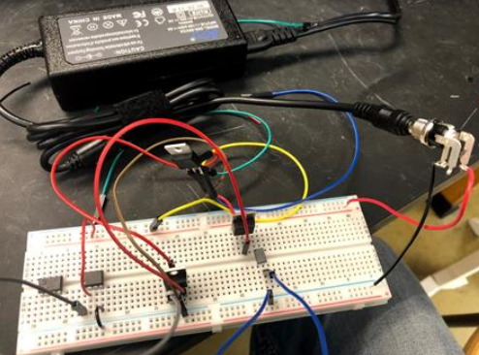
Curve Tracer V2 Prototype

Slide 16
11/1-11/7
Create control code for Digital Potentiometers in order to test circuit
Test Digital Potentiometers that were ordered with the code.
Only 1 of the 4 Digital Potentiometers that were received worked correctly. Seems like very bad luck from Digikey

Slide 17
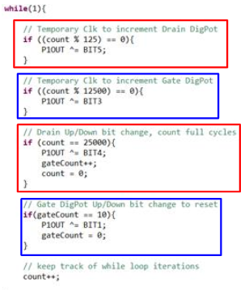
Initial Curve Tracer Control Code

Slide 18
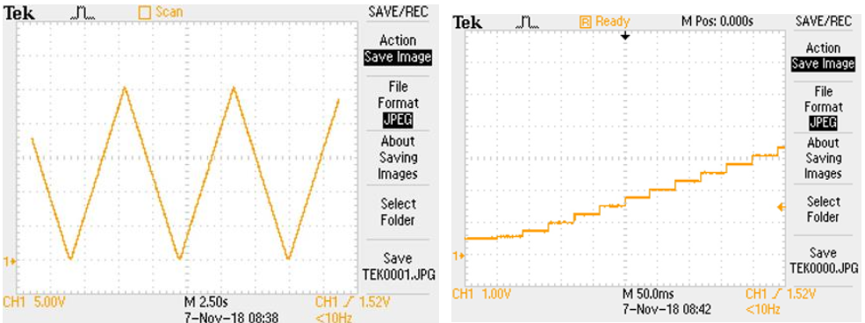
Digital Potentiometer Test Output (With Code)

Slide 19
11/8-11/14
Family Emergency, all progress put on hold

Slide 20
11/15-11/25
Reordered parts to replace duds
Thanksgiving Holiday

Slide 21
11/25-12/1
Implemented Gate Drivers in to the circuit
Finished Curve Tracer circuit
Prepare for Demo Day
Solder circuit, burnt out from what seems to be too high of a duty cycle, leaving the transistor on too long.

Slide 22
11/25-12/1
Implemented Gate Drivers in to the circuit
Finished Curve Tracer circuit
Prepare for Demo Day
Solder circuit, burnt out from what seems to be too high of a duty cycle, leaving the transistor on too long.

Slide 23
12/2-12/4
Rebuild circuit on non-solder breadboard
Test Curve Tracer and get data for Final Presentation
Prepare final Presentation

